Slide 1

Pilltender
Automated Pill Dispenser for Seniors with Memory Loss
Shadman Abedin · Allison Chou · Celina Hipolito · Will Wang

Slide 2
Problem
Call James
Take Medicine
Dinner with Alice
Doctor’s Appointment
Pick up glasses
Take medicine
Drop off Matthew

Slide 3
Problem
Memory loss is a common problem with aging
Take Medicine
Dinner with Alice
Doctor’s Appointment
Pick up glasses
Take medicine
Drop off Matthew

Slide 4
Problem
Memory loss is a common problem with aging
Reminders help both seniors and caretakers
Take Medicine
Dinner with Alice
Doctor’s Appointment
Take medicine
Drop off Matthew

Slide 5
Problem
Memory loss is a common problem with aging
Reminders help both seniors and caretakers
Forgetting to set up reminders
Take Medicine
Doctor’s Appointment
Take medicine

Slide 6
Problem
Memory loss is a common problem with aging
Reminders help both seniors and caretakers
Forgetting to set up reminders
Difficult to learn new behavior
Take Medicine
Take medicine

Slide 7
Problem
Memory loss is a common problem with aging
Reminders help both seniors and caretakers
Forgetting to set up reminders
Difficult to learn new behavior
Broad solution ineffective

Slide 8
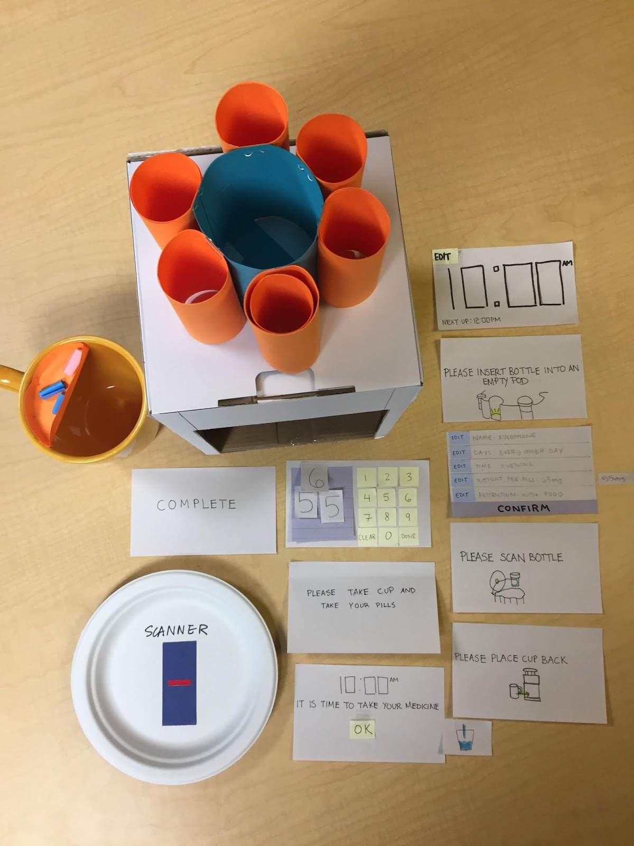
Problem
Initial Paper Prototype
Pilltender machine
Scanner
Pods
Specialized cup

Slide 9
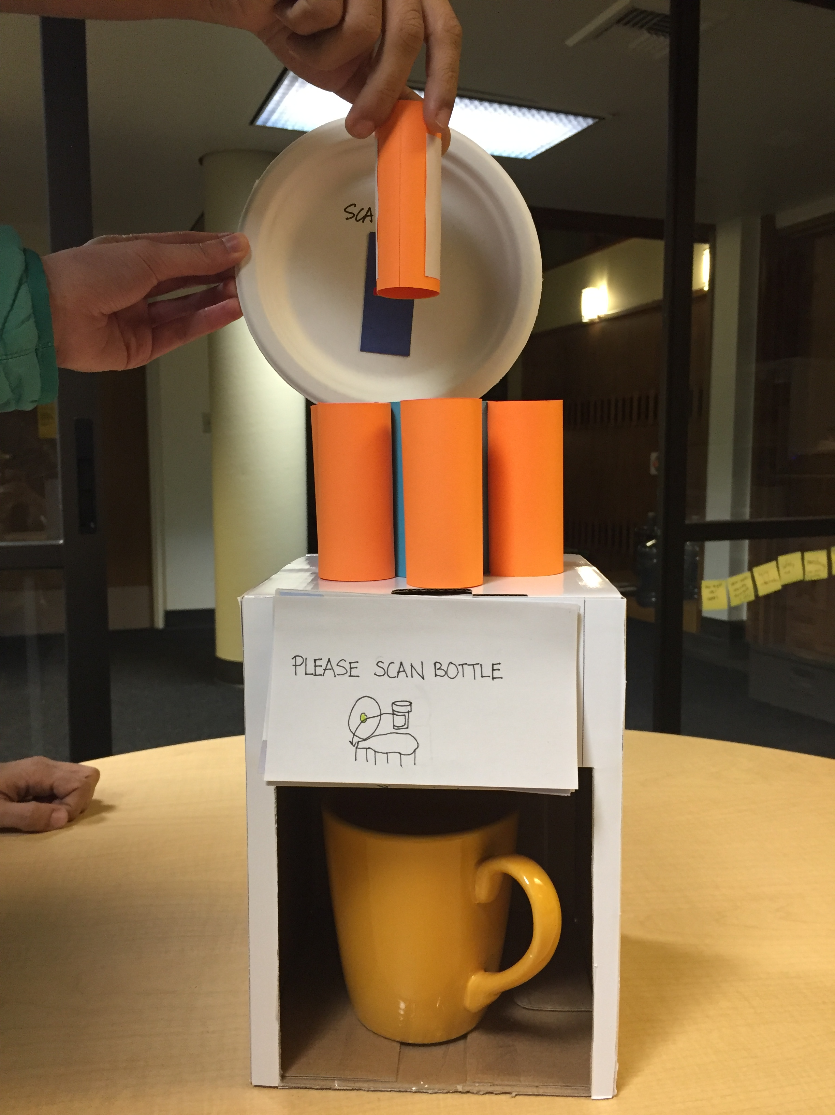
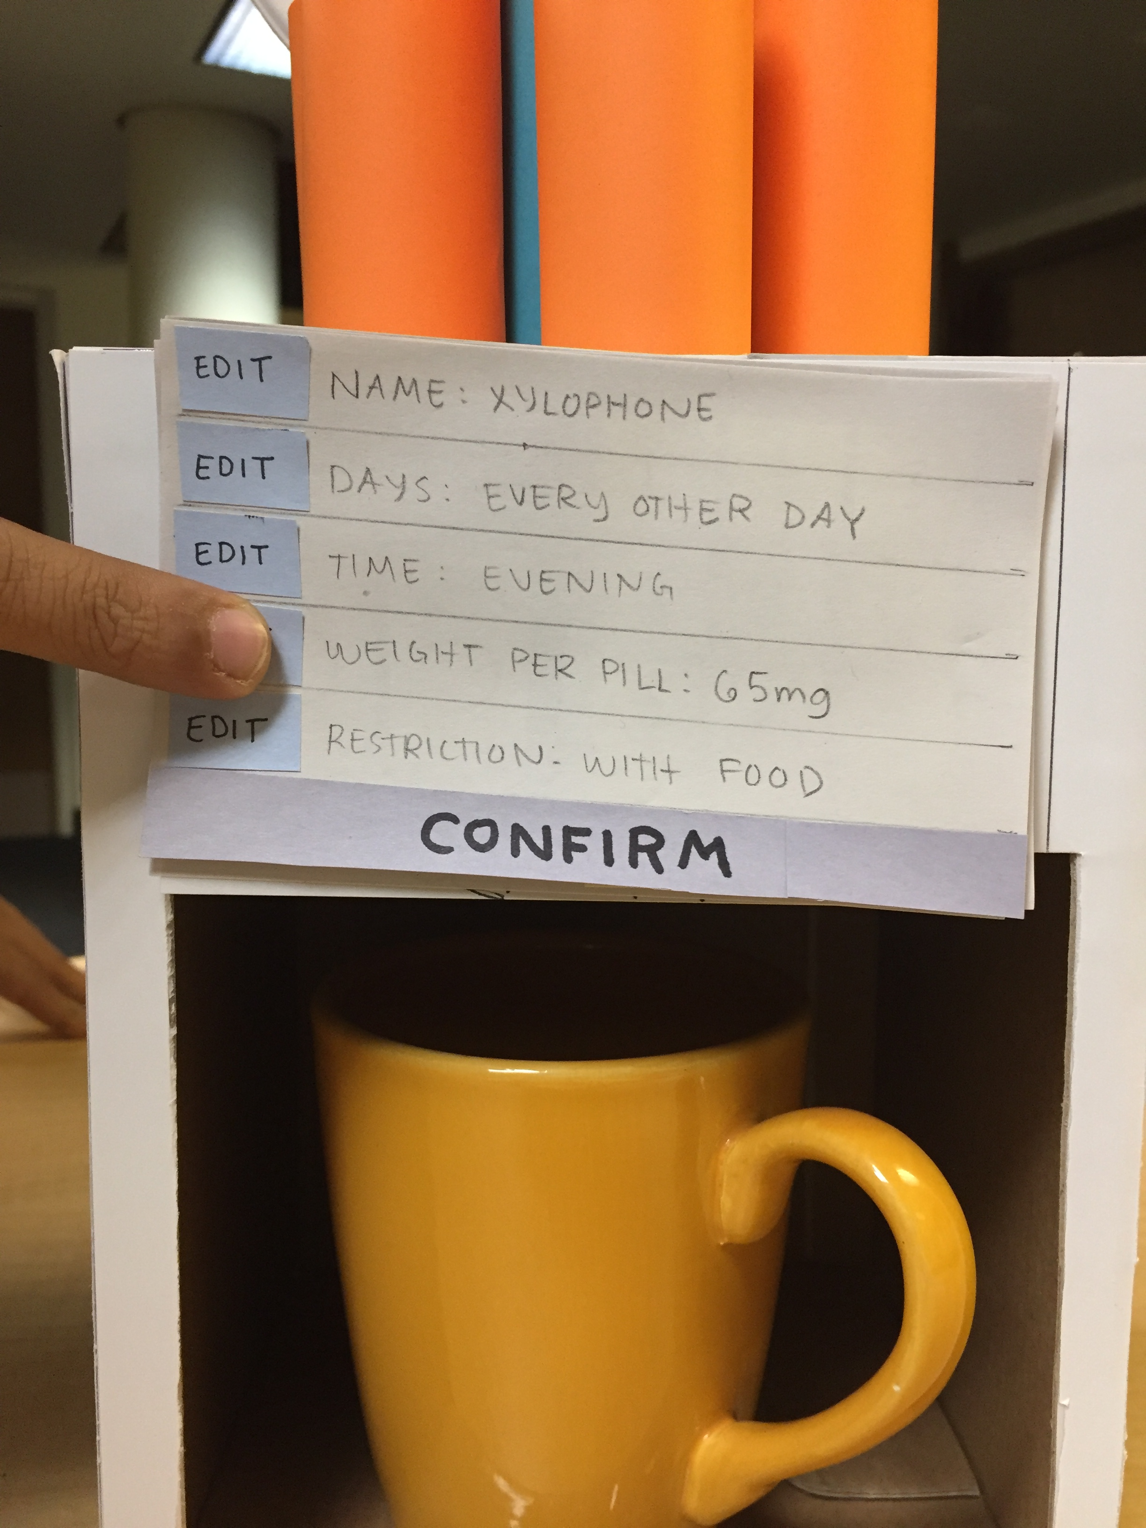
Initial Paper Prototype Task 1: Adding Medicine

Slide 10
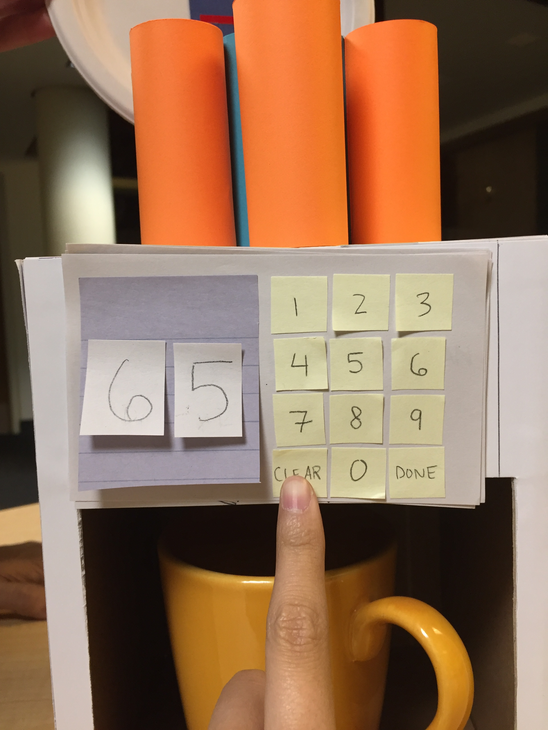
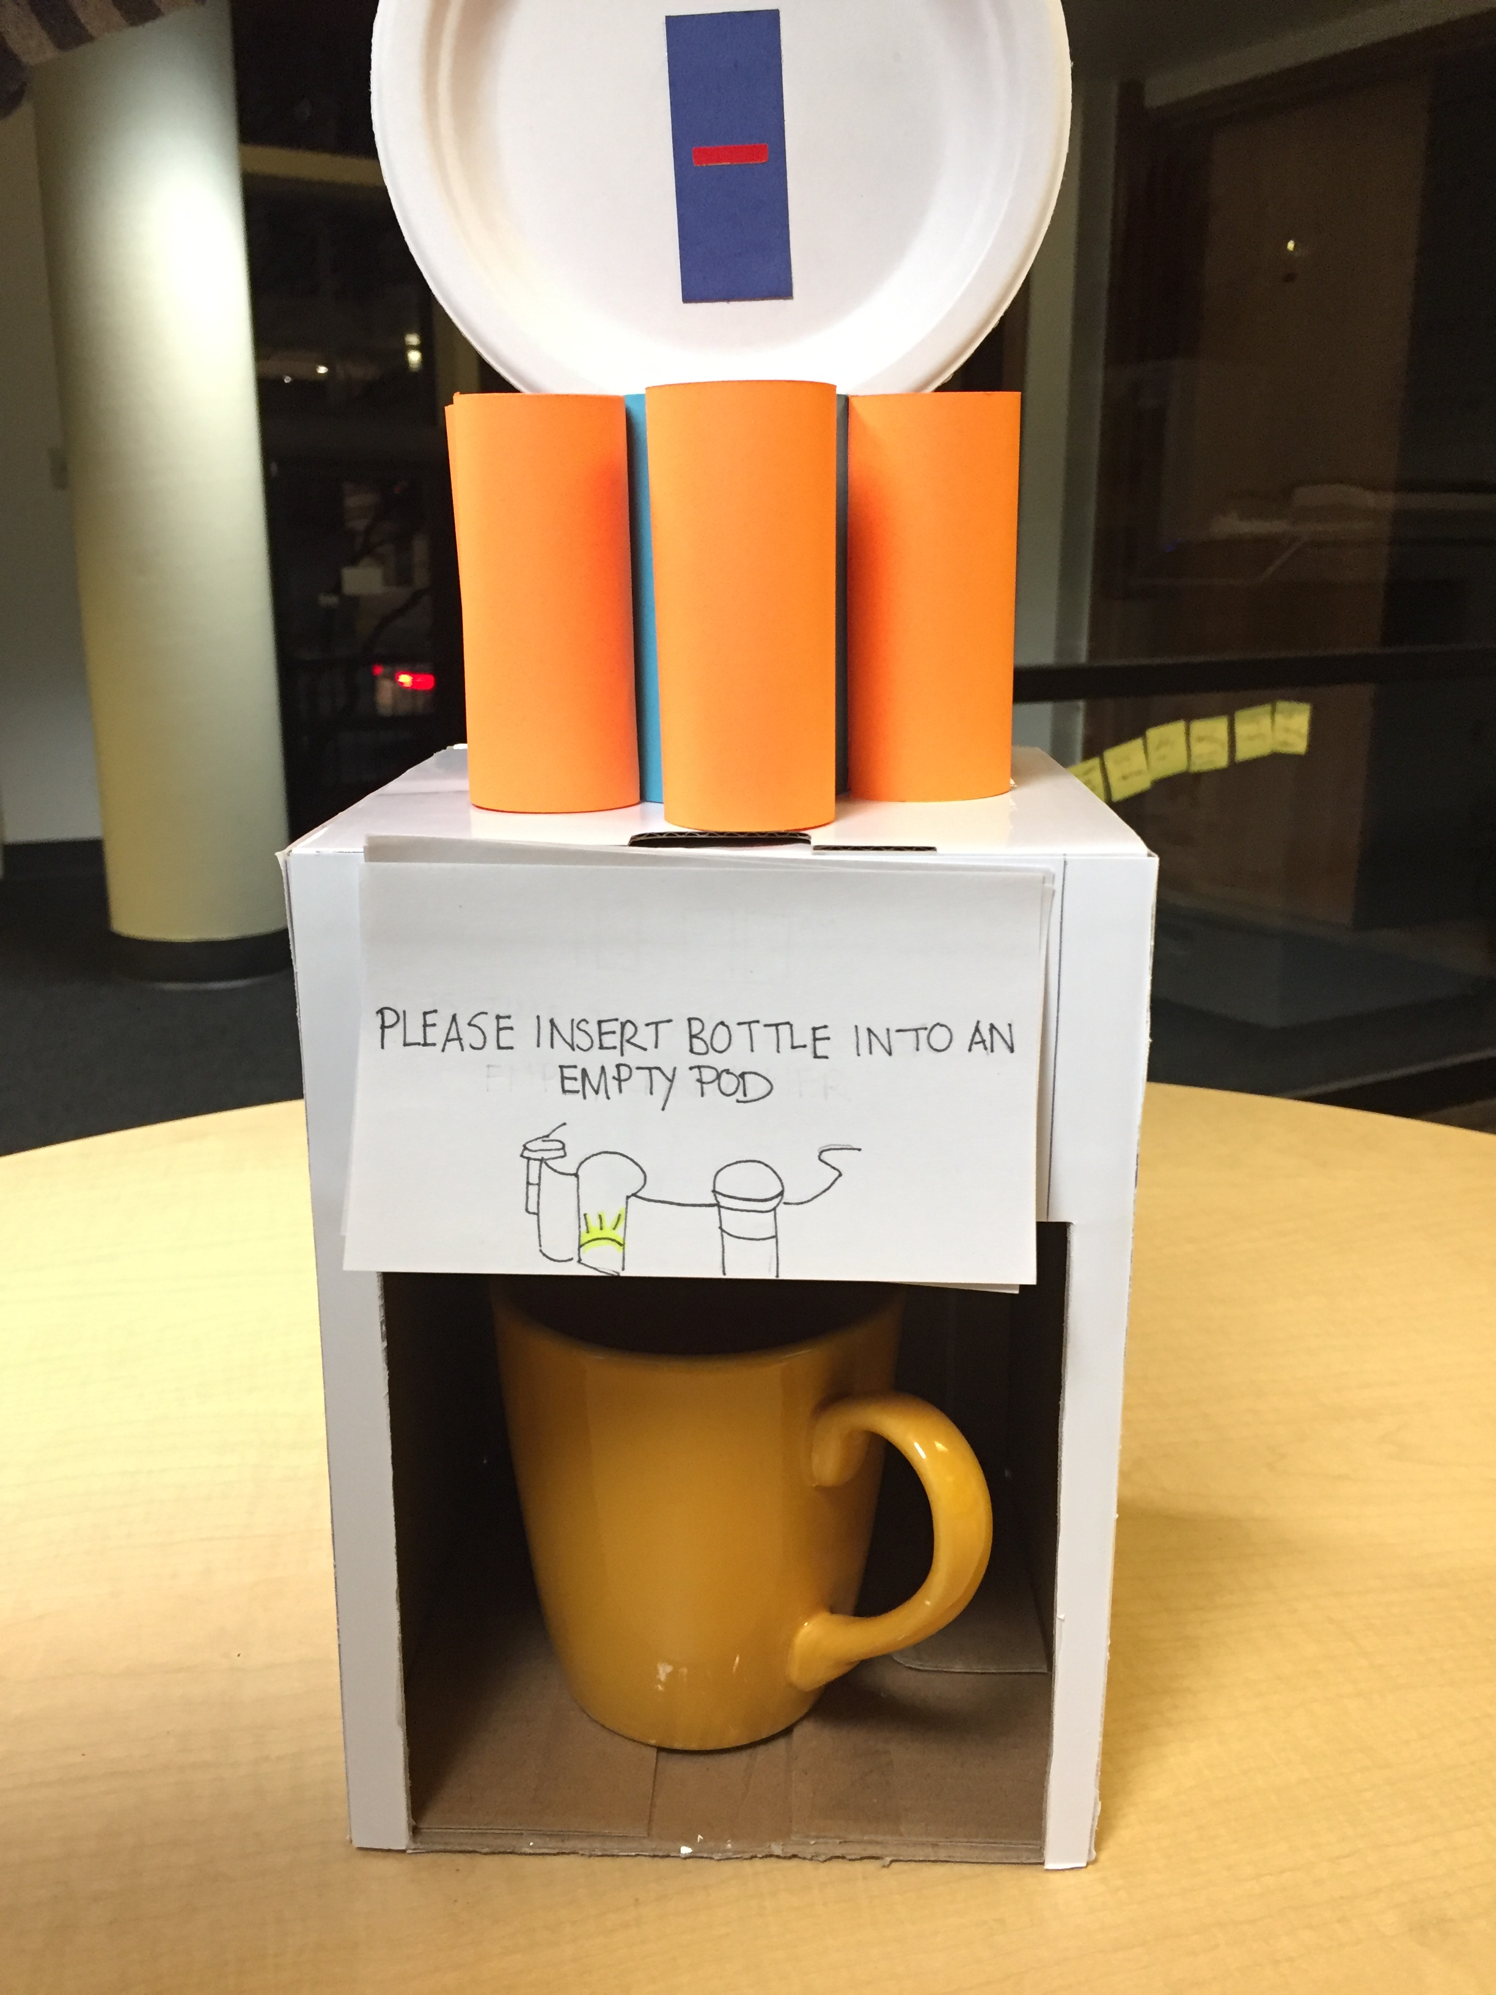
Initial Paper Prototype Task 1: Adding Medicine
Point 1
Point 2
Point 3
Point 4
Point 5

Slide 11
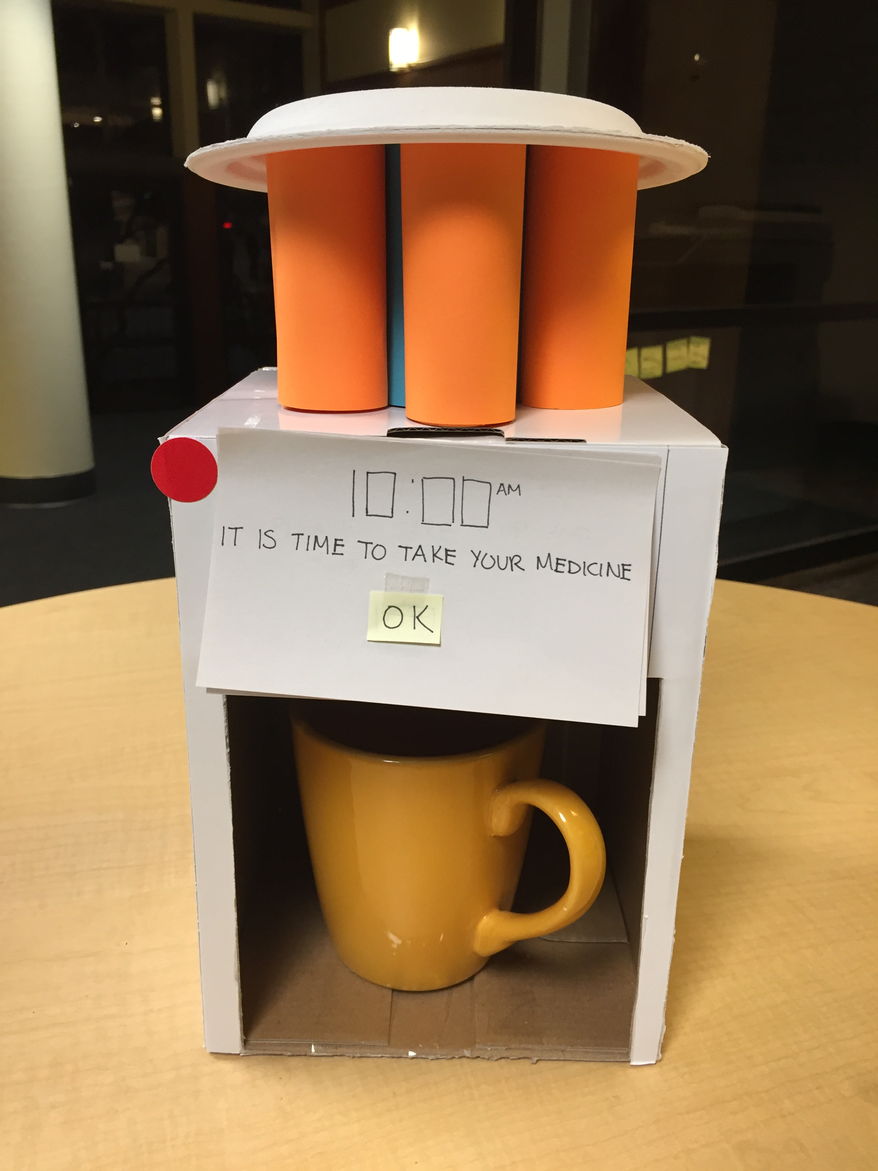
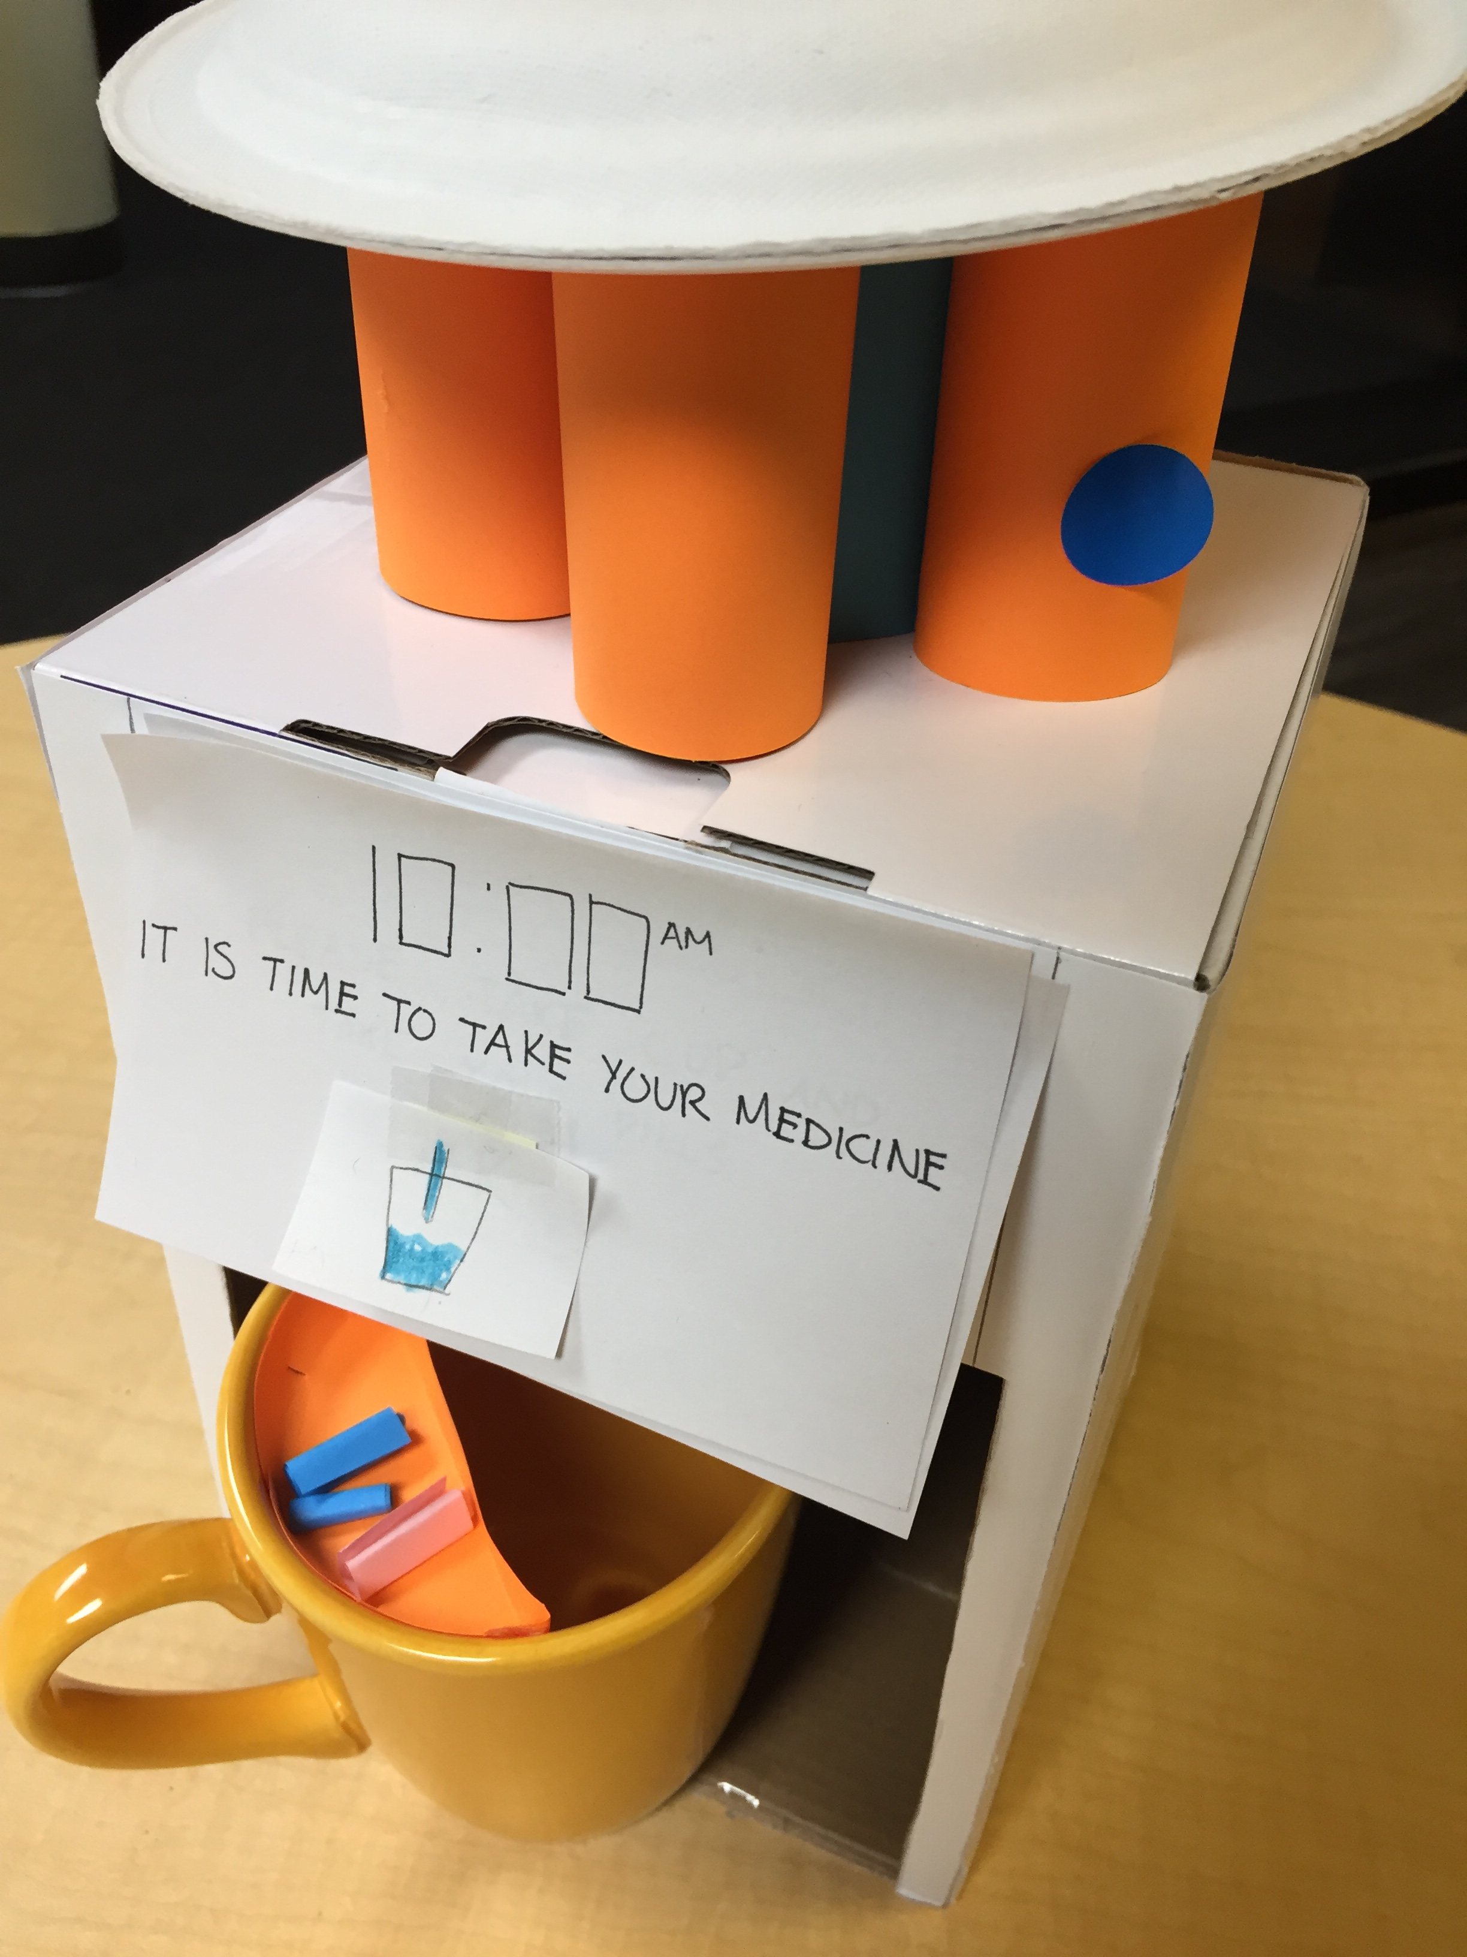
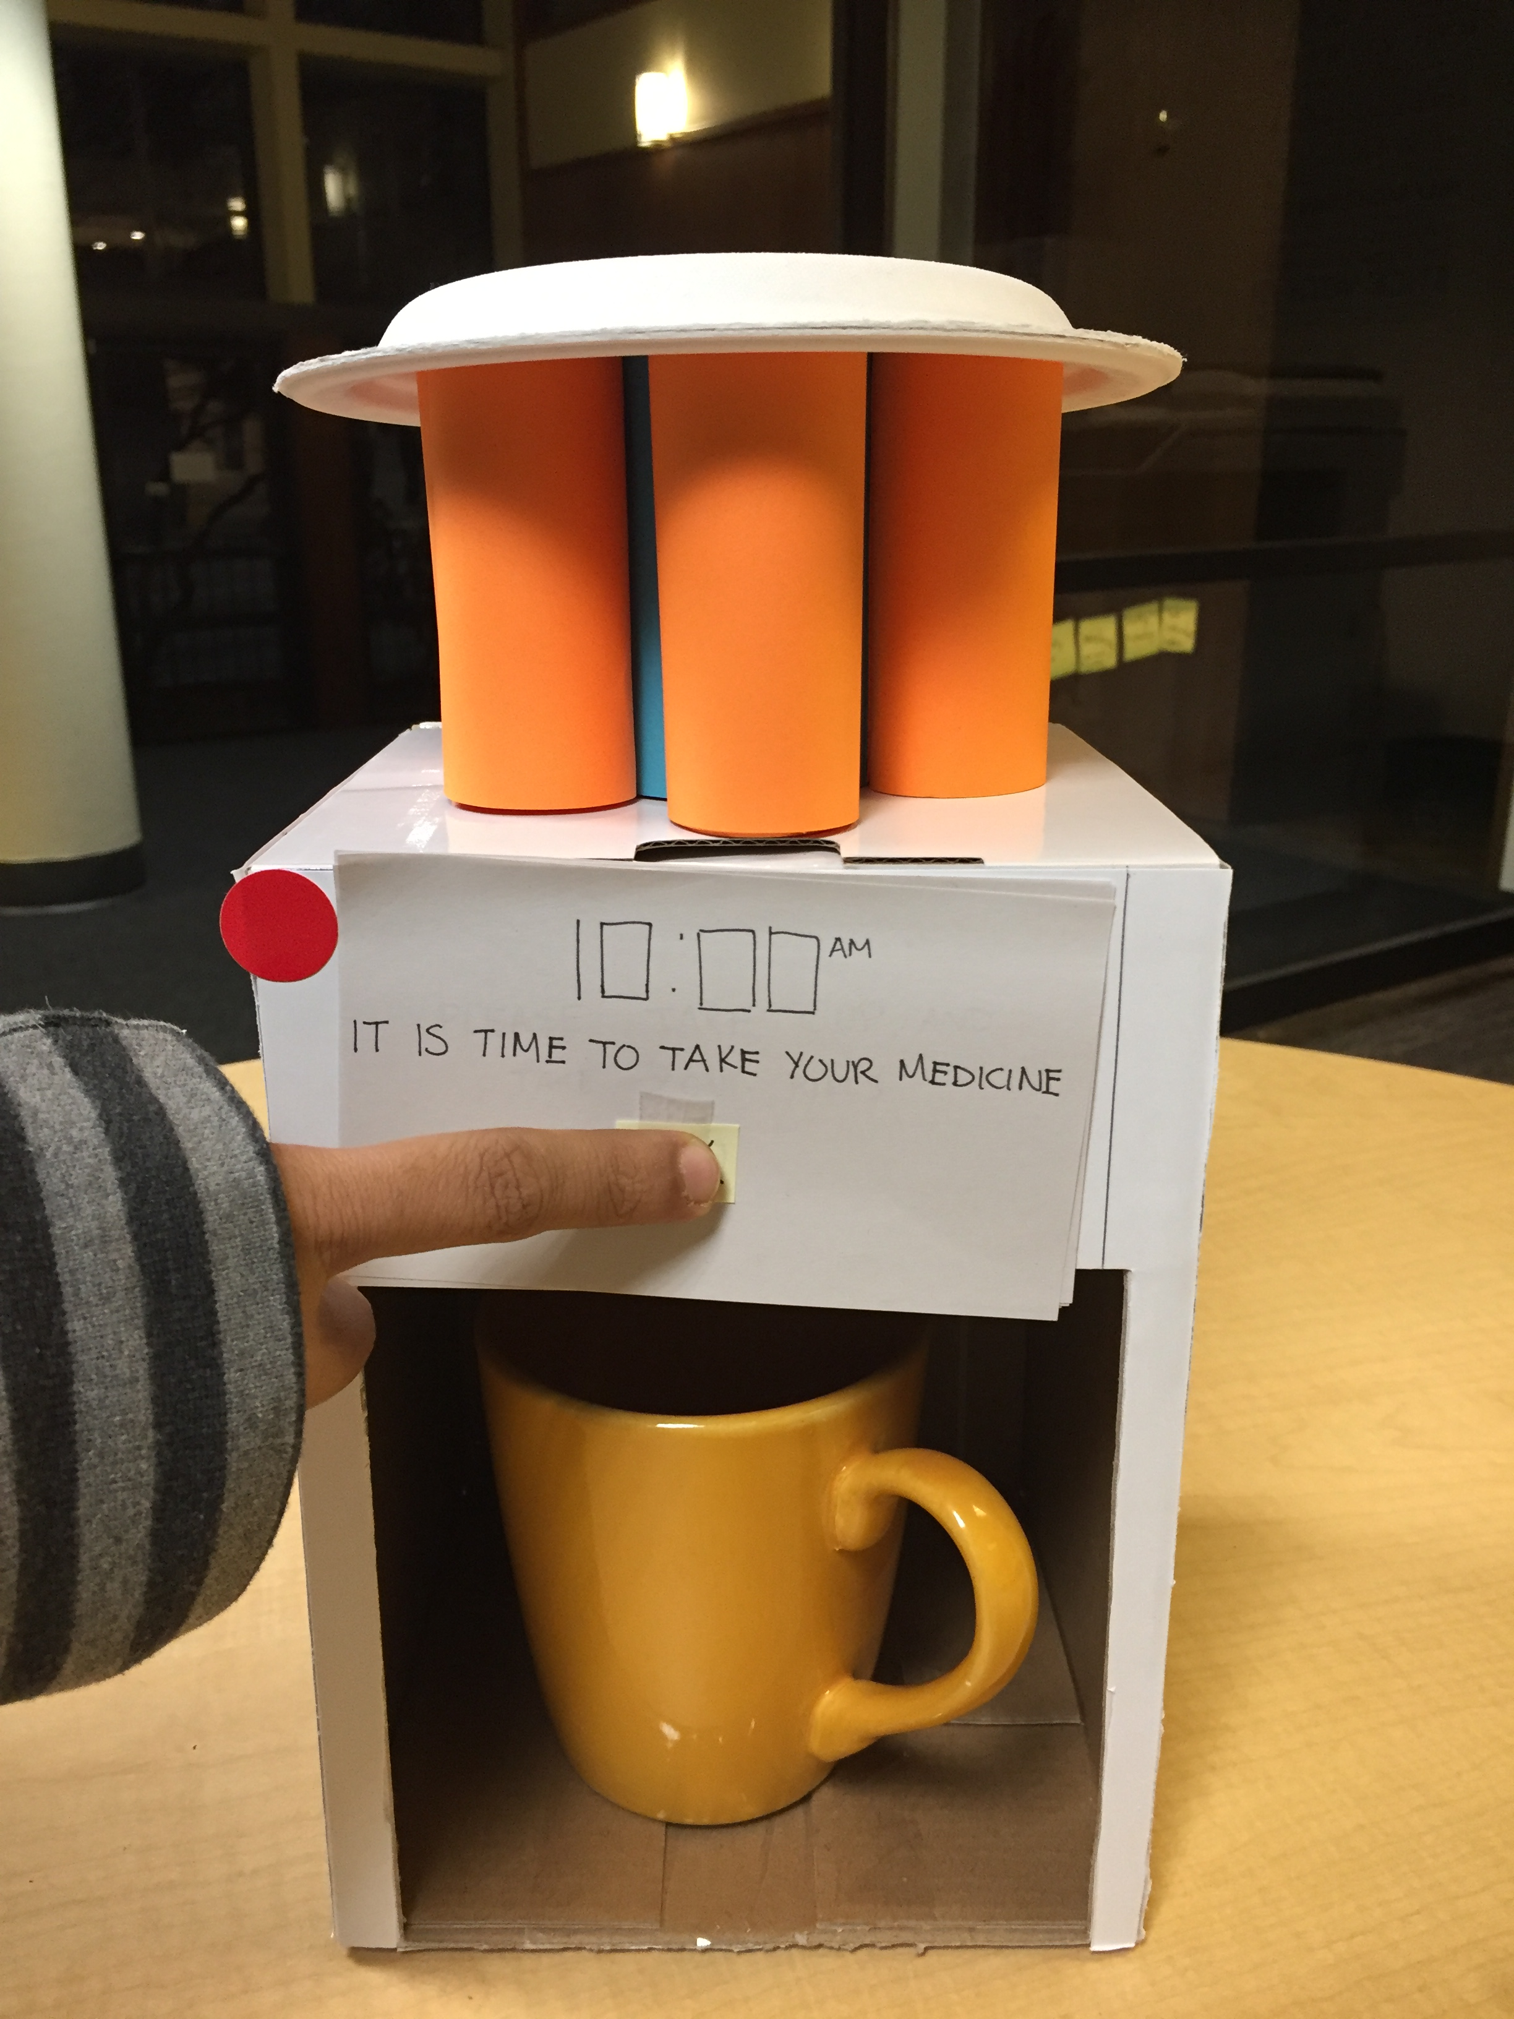
Initial Paper Prototype Task 2: Taking Medicine
Point 1
Point 2
Point 3
Point 4
Point 5

Slide 12
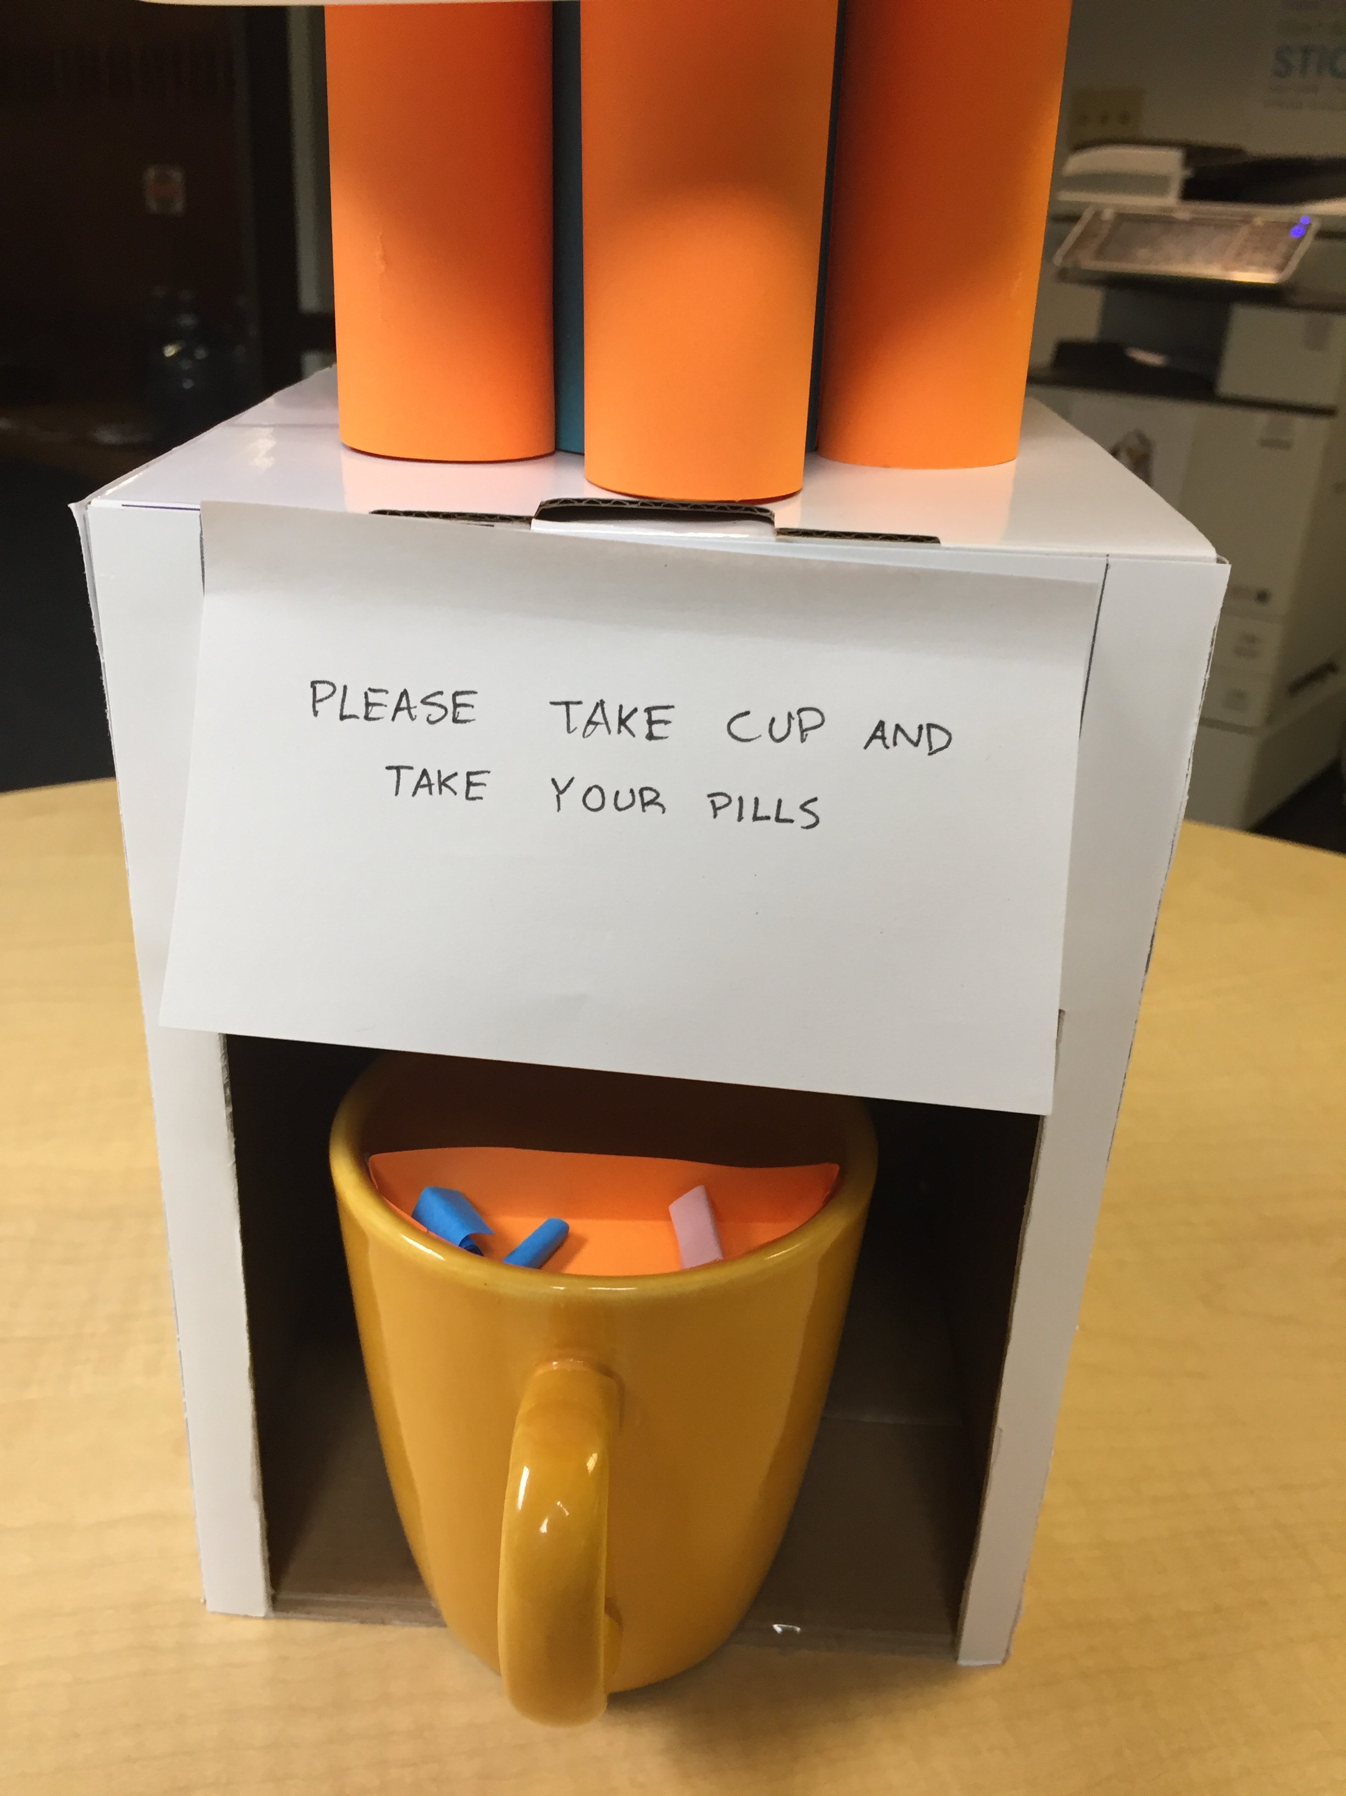
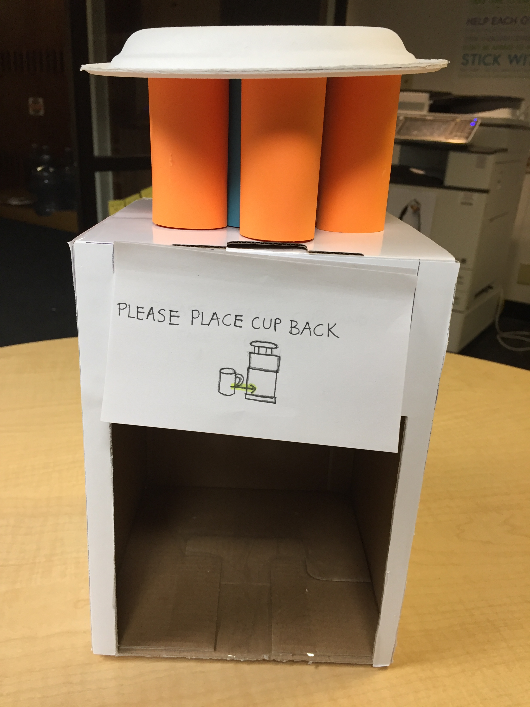
Initial Paper Prototype Task 2: Taking Medicine
Point 1
Point 2
Point 3
Point 4
Point 5

Slide 13


Testing Process
2 heuristic evaluations
3 usability tests

Slide 14



Testing Results
Flexibility of use
Visibility of System Status
Error prevention

Slide 15
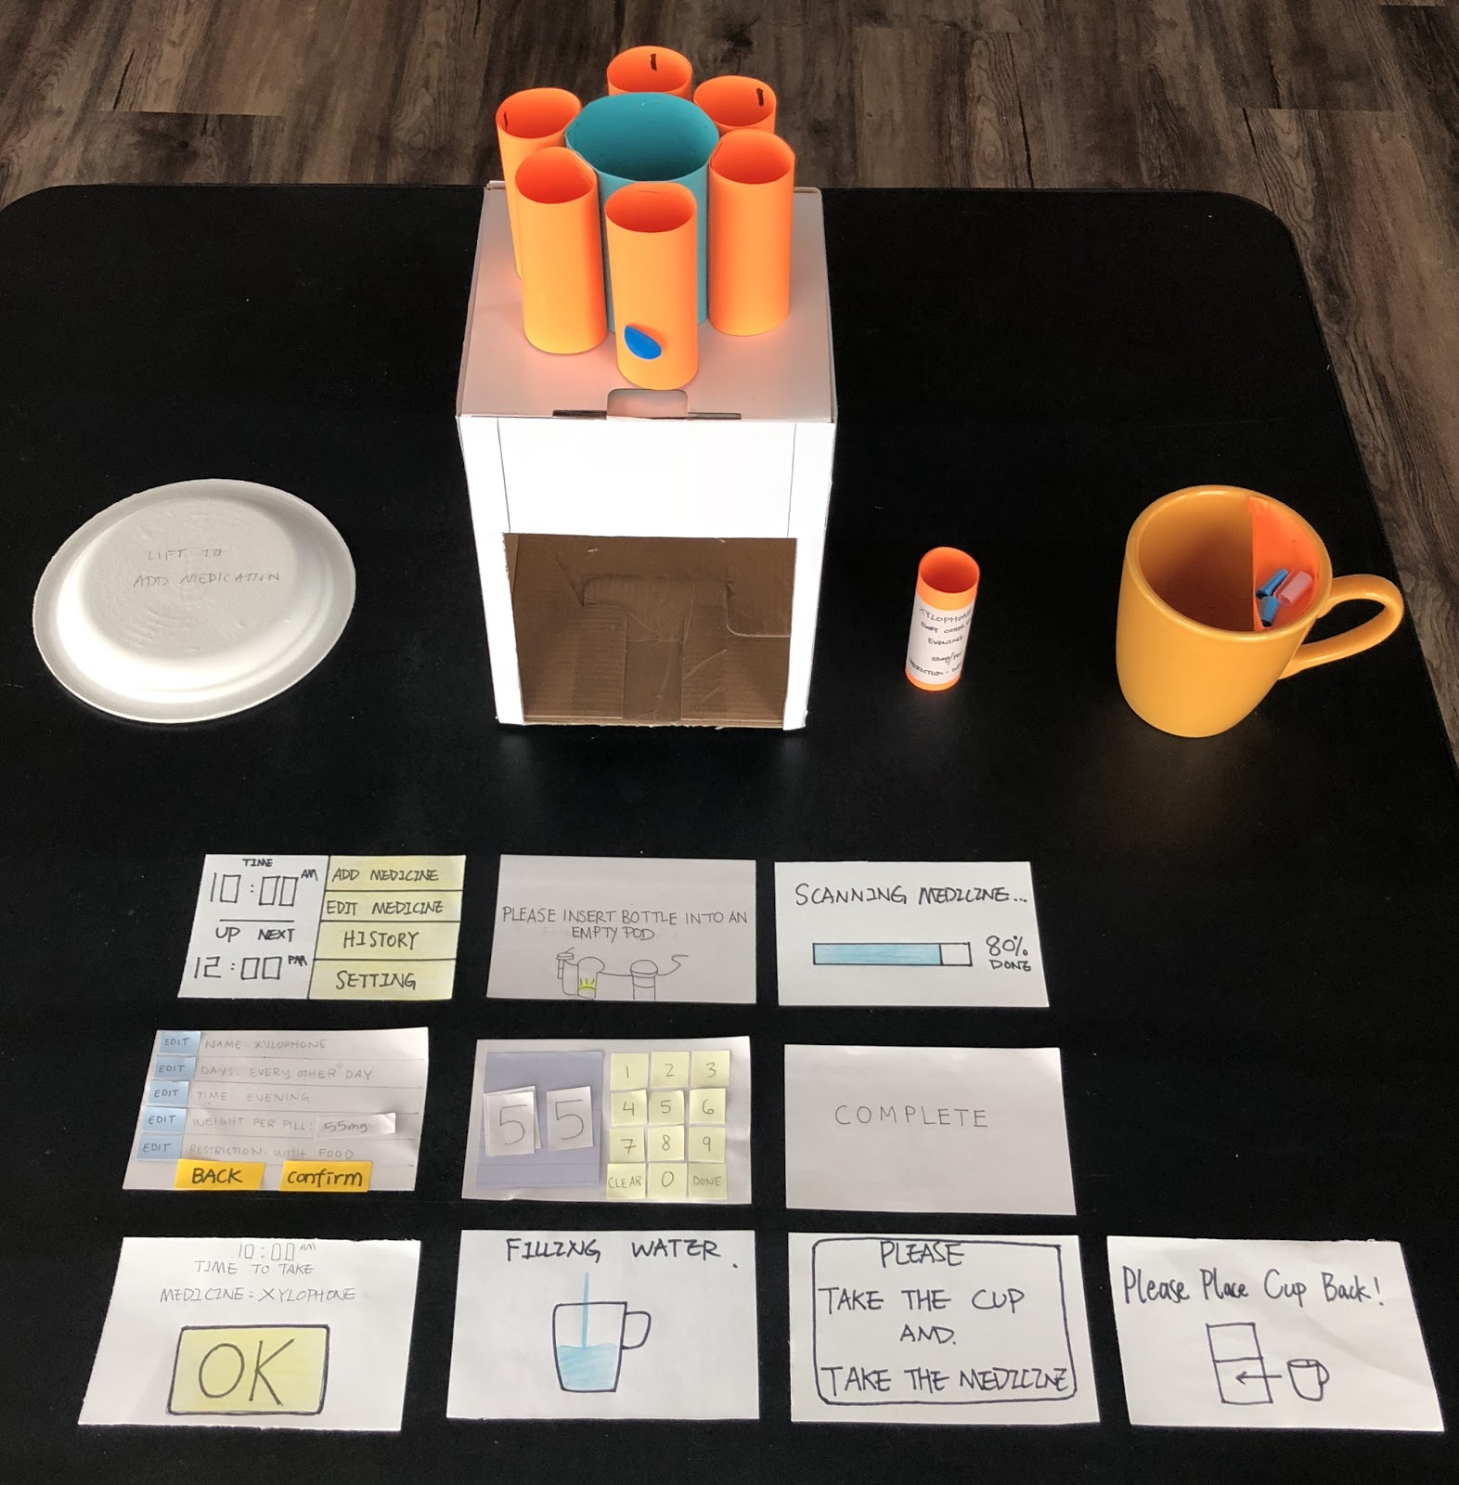
Final Paper Prototype
Scanners in pod
Larger text and buttons
Progress bar
Hidden menu in home screen

Slide 16
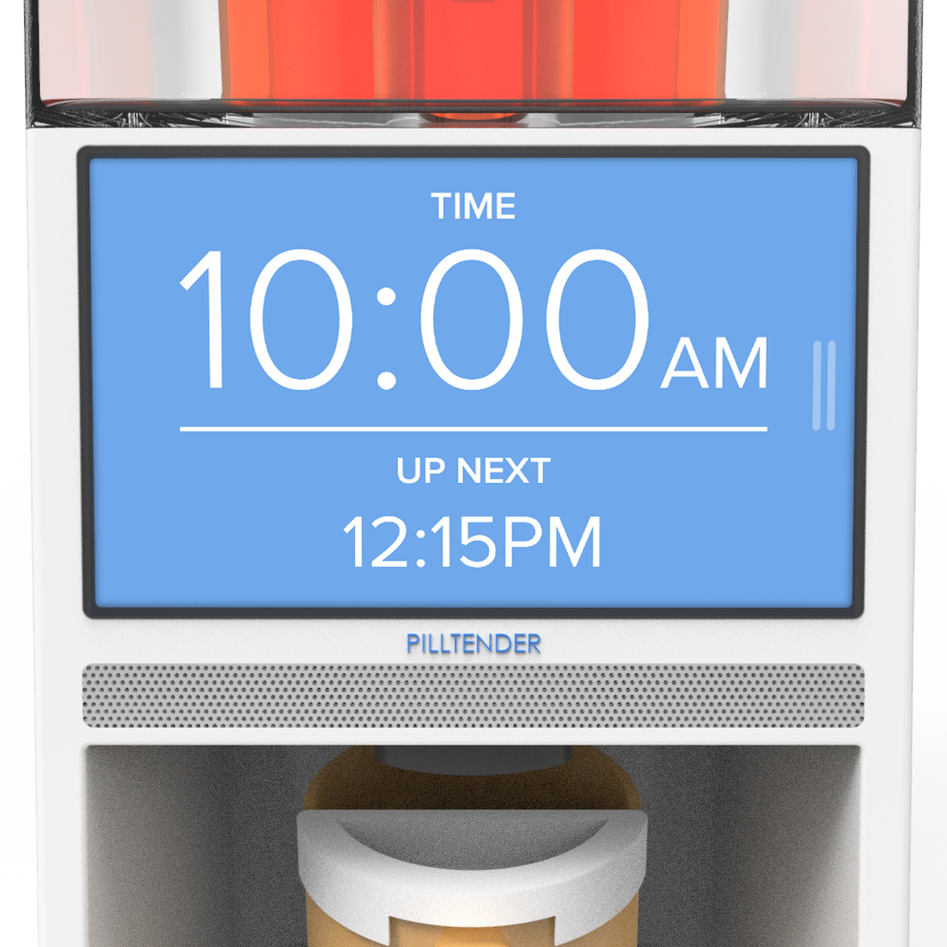
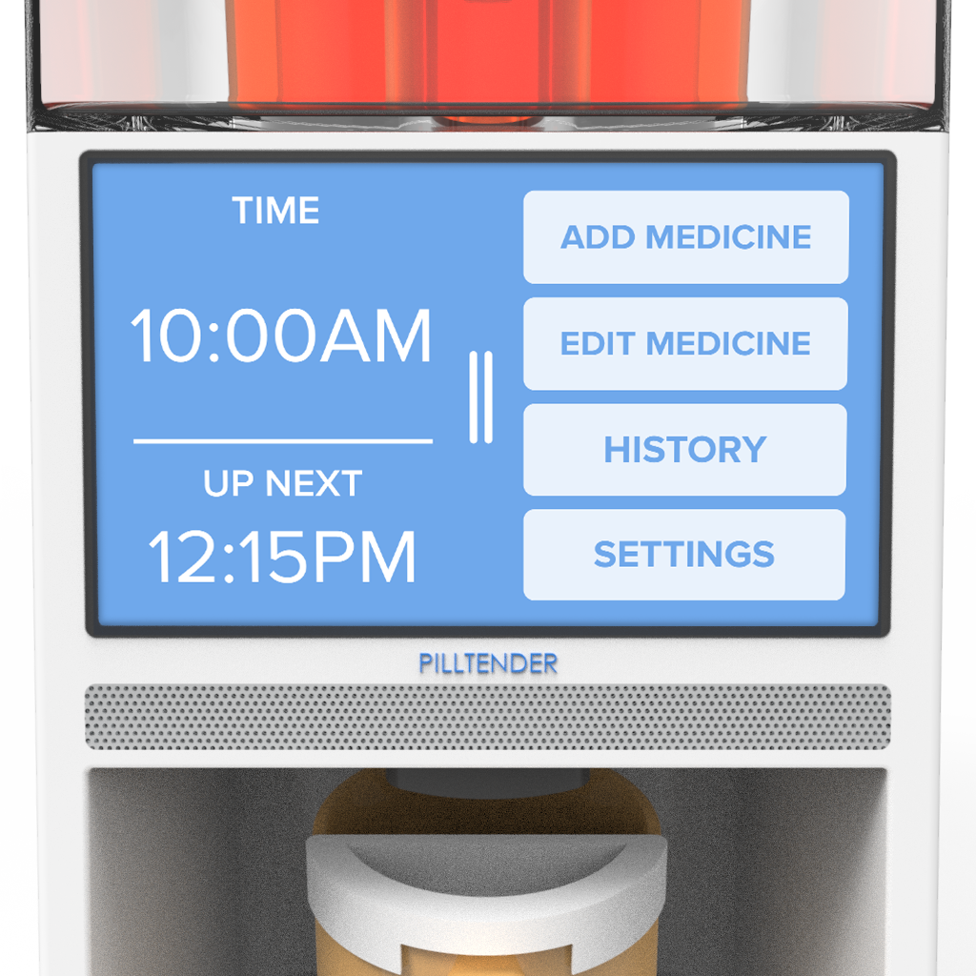
Digital Mockup Task 1: Adding Medicine

Slide 17
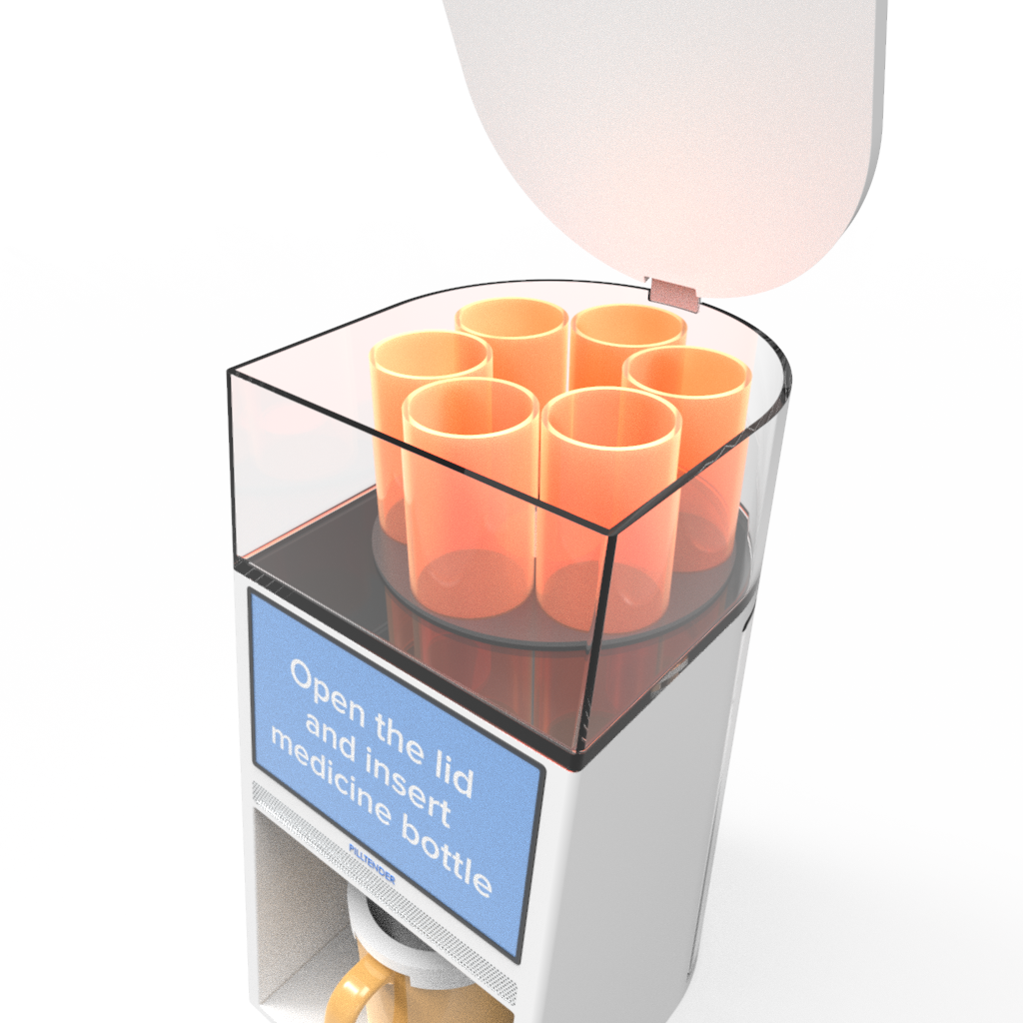
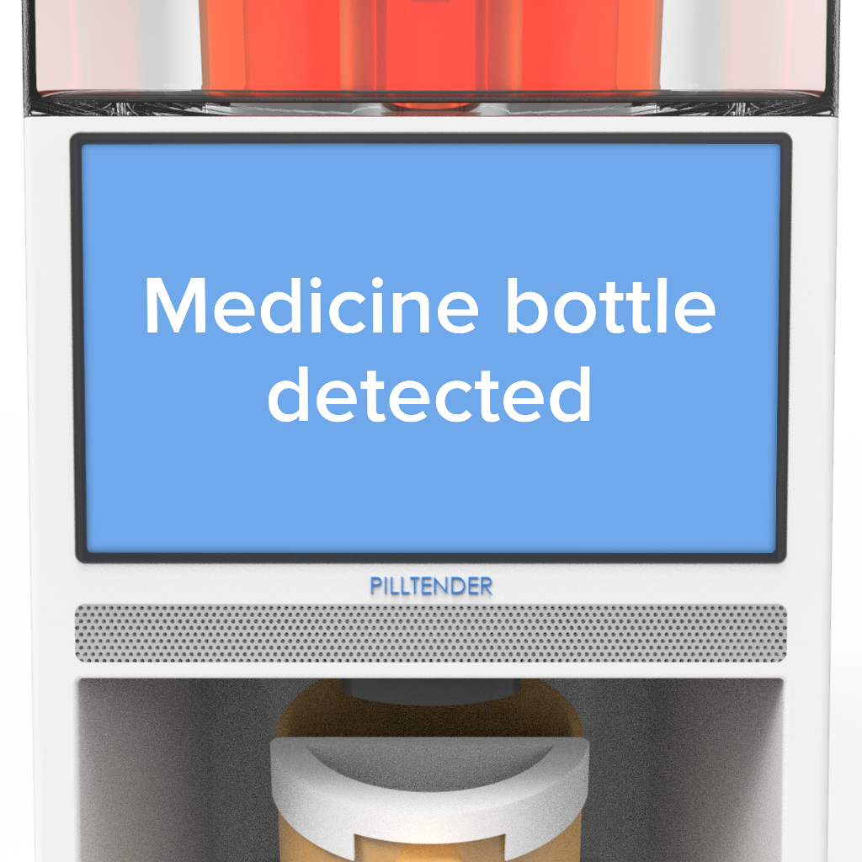
Digital Mockup Task 1: Adding Medicine

Slide 18
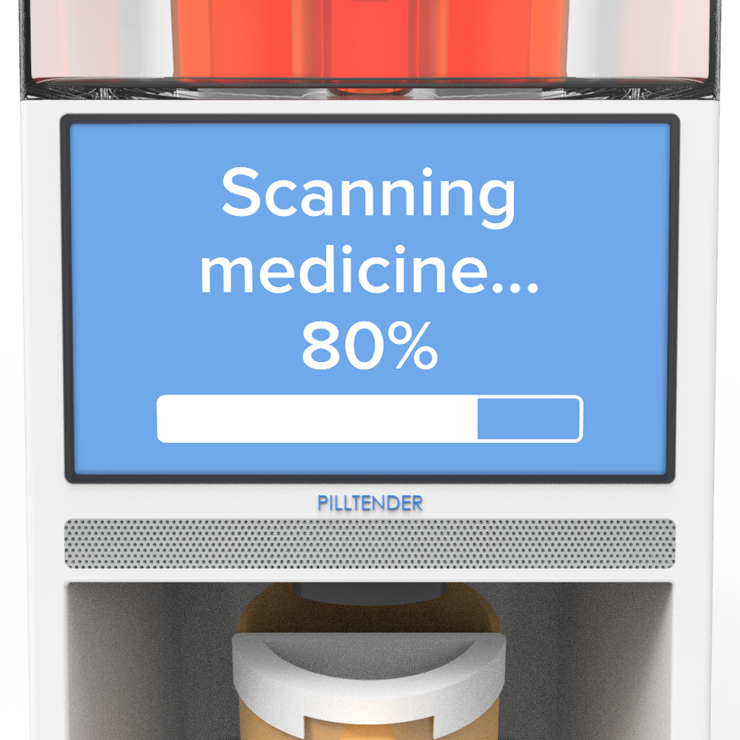
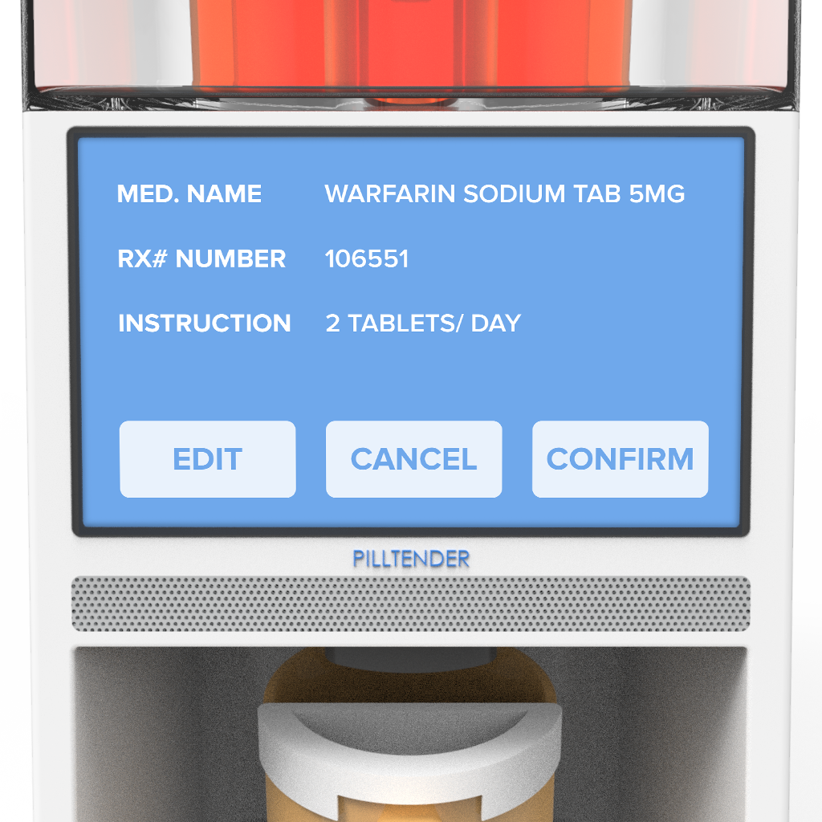
Digital Mockup Task 1: Adding Medicine

Slide 19
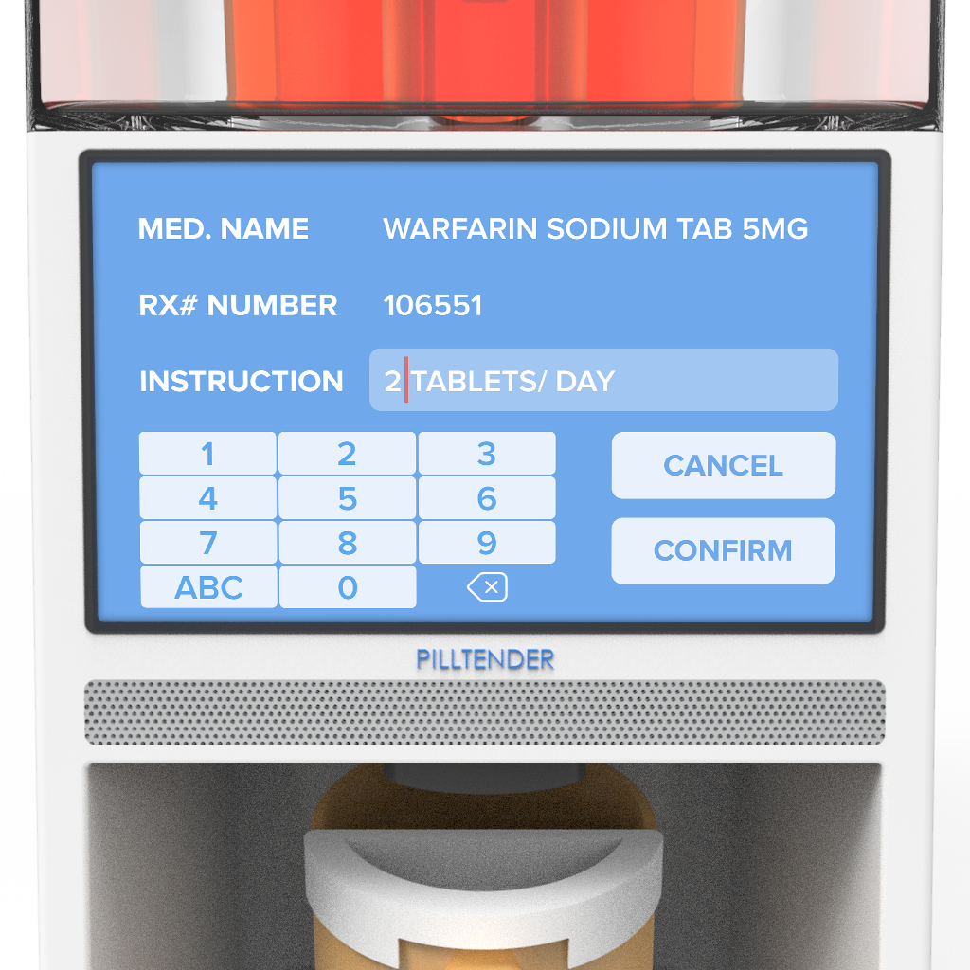
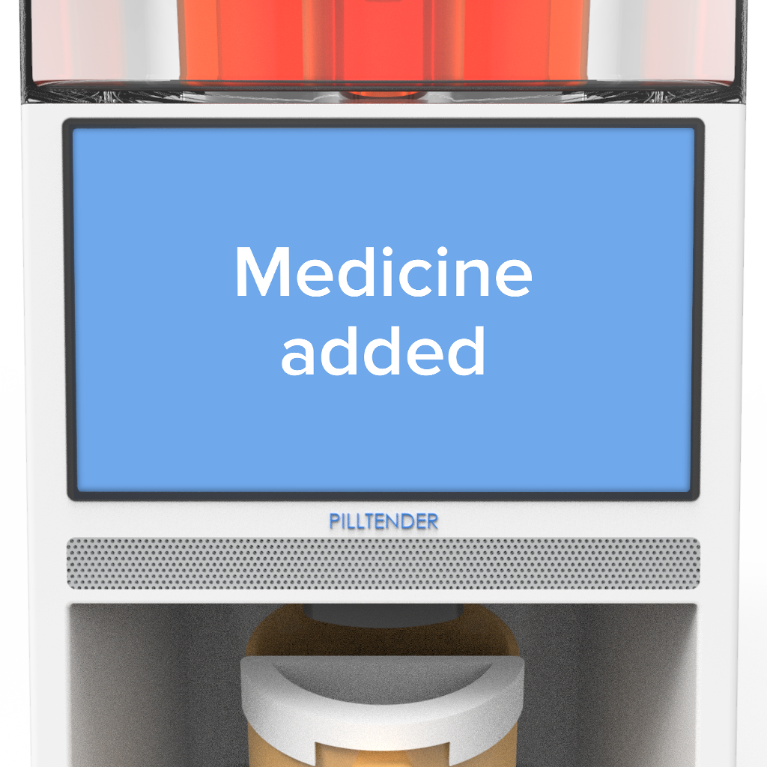
Digital Mockup Task 1: Adding Medicine

Slide 20
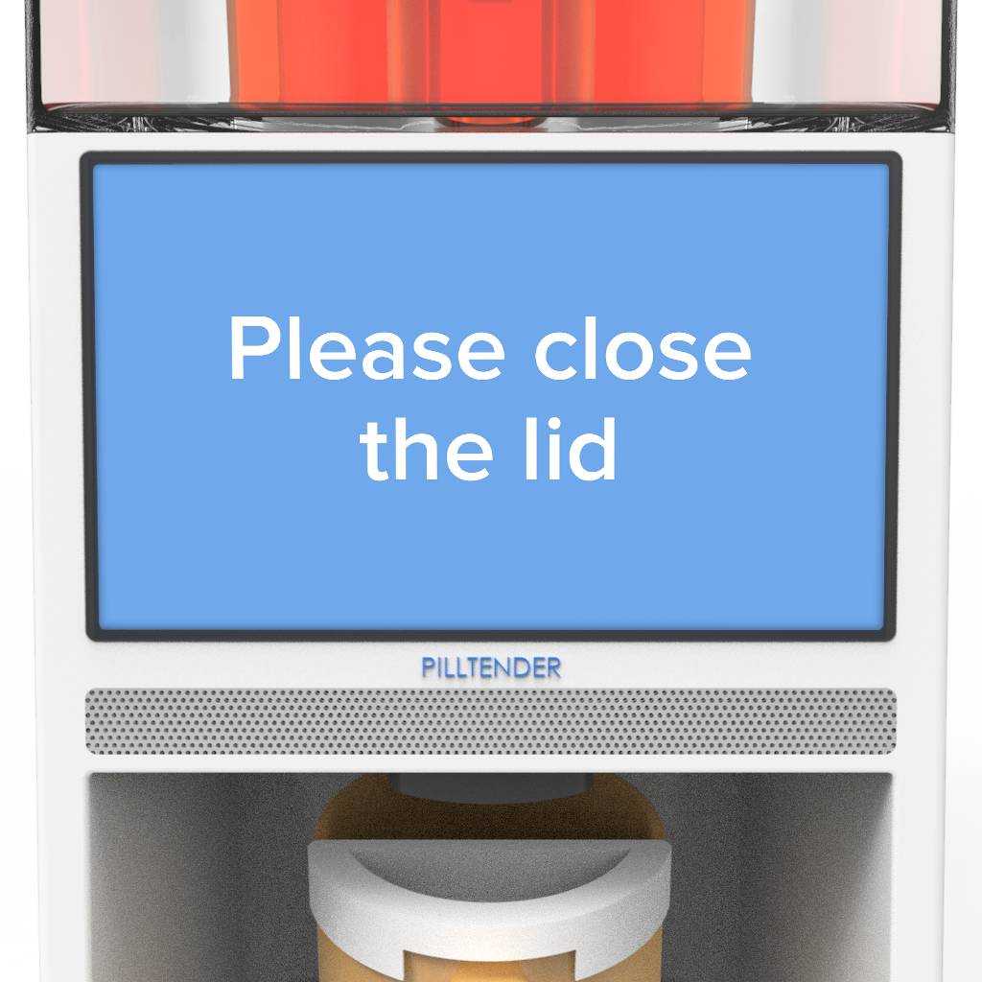
Digital Mockup Task 1: Adding Medicine

Slide 21
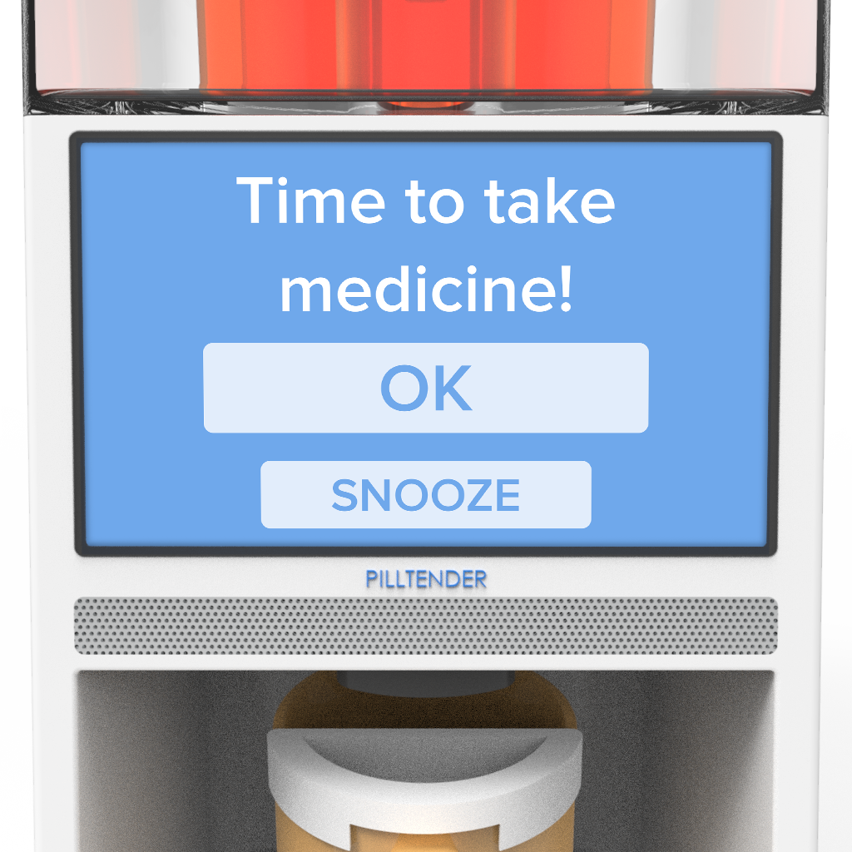
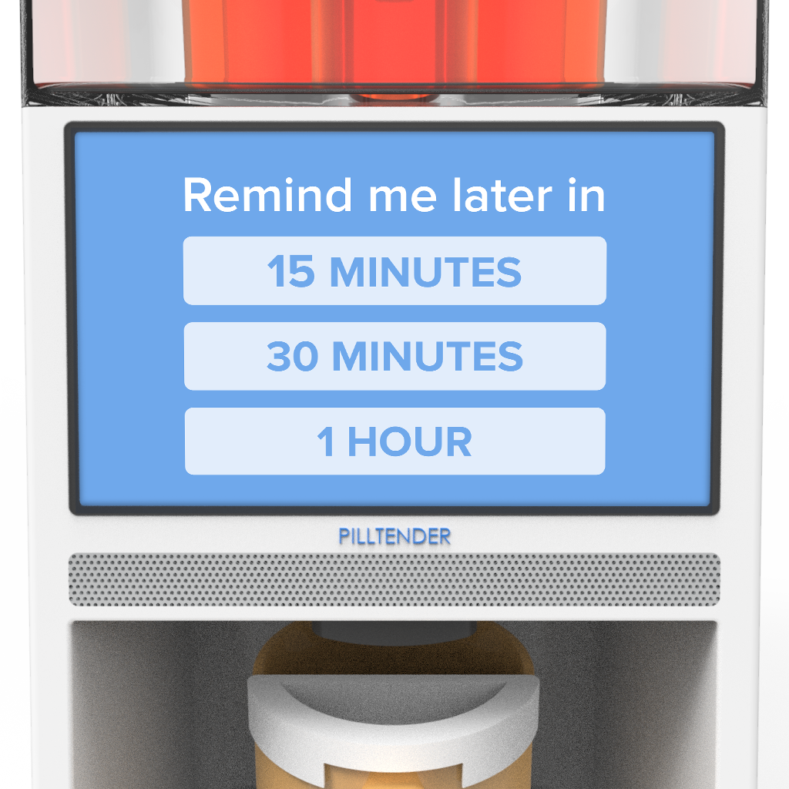
Digital Mockup Task 2: Taking Medicine

Slide 22
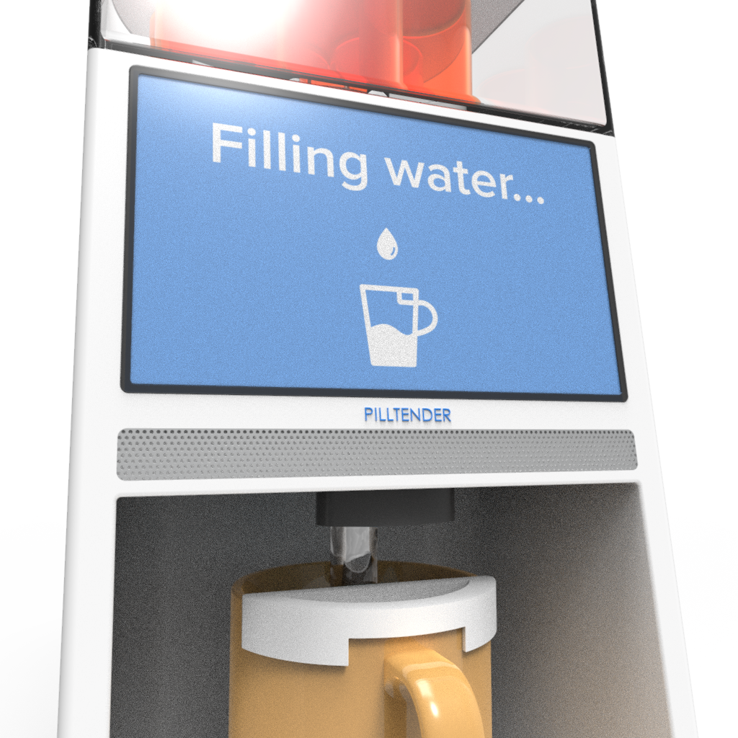
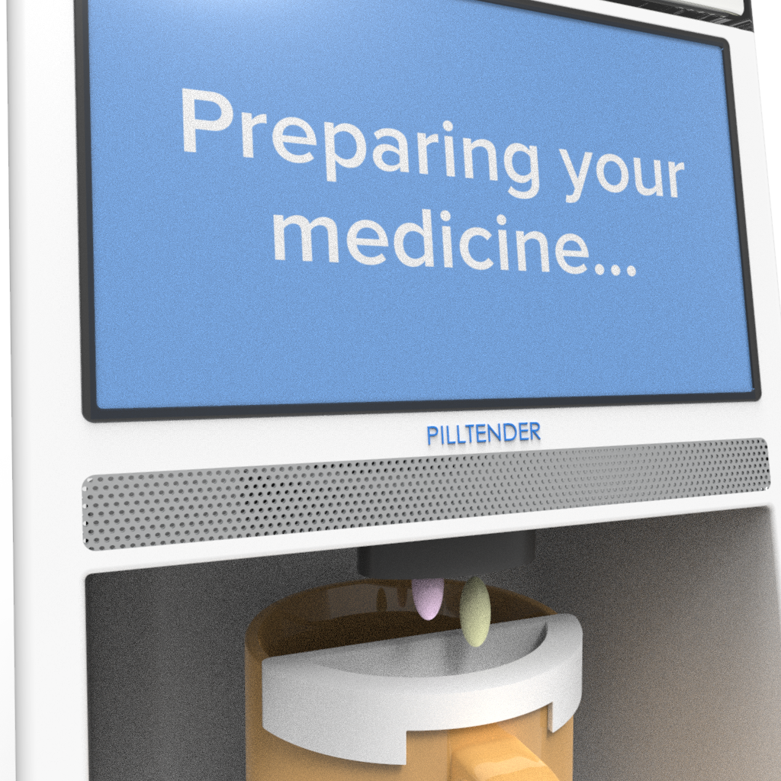
Digital Mockup Task 2: Taking Medicine

Slide 23
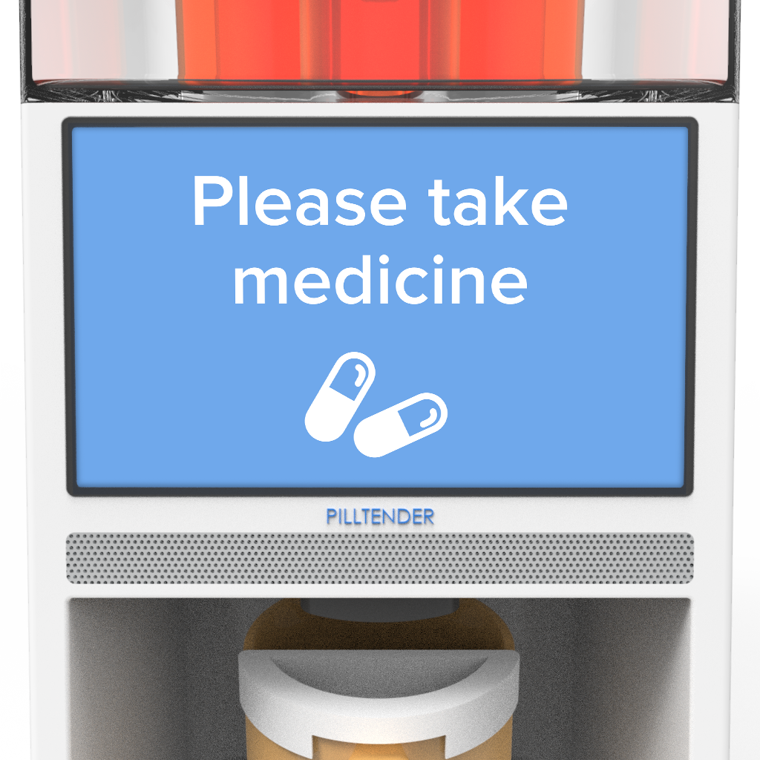
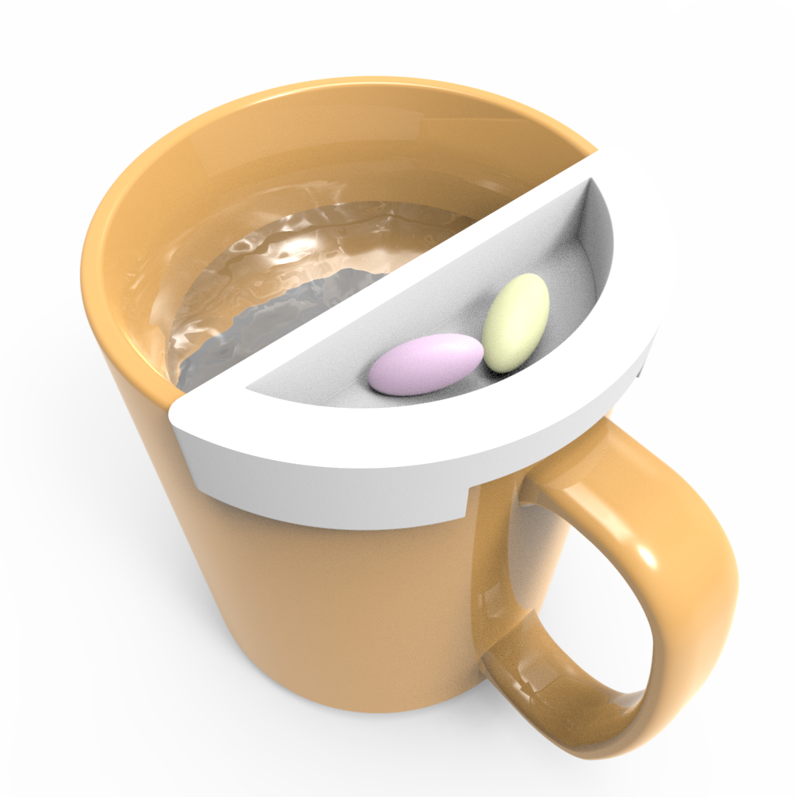
Digital Mockup Task 2: Taking Medicine

Slide 24
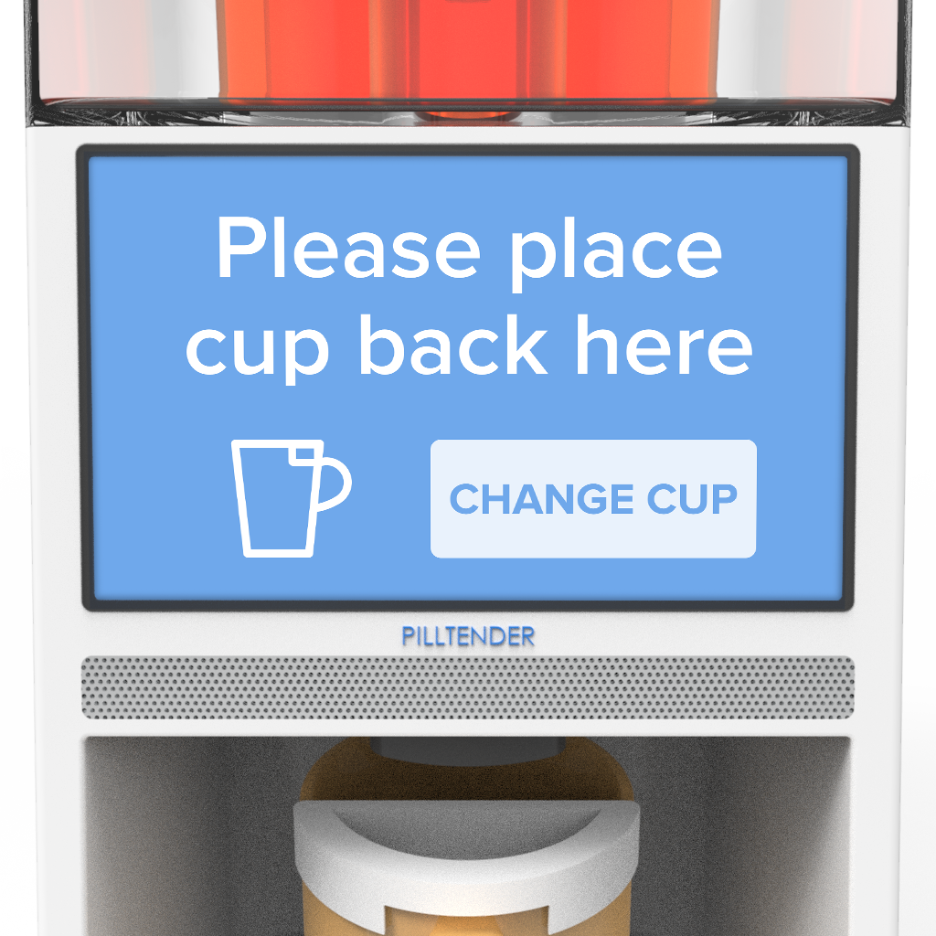
Digital Mockup Task 2: Taking Medicine

Slide 25
Key Takeaways
Tailoring usability testing methods such as heuristic evaluation to our project is important
Helpful if usability tests are conducted before every major improvement of the prototype
Maximizing the variety of participants within a target group helps gain more inclusive insights from usability testing

